Slide 1
Developing a daily time step individual level demographic simulation model
Andy Turner
http://bit.ly/TStpJP
Presentation slides prepared for a CSAP research cluster meeting, School of Geography, University of Leeds, UK, 2012-12-11
Notes:
Presentation slides prepared for a CSAP research cluster meeting, School of Geography, University of Leeds, UK, 2012-12-11
I last presented this work at the 2011 UK e-Science All Hands Meeting in York (https://docs.google.com/document/d/1jSJ08Y09Ga2wya6GvqMqi4CsKbqAb3FjOqMK_-INdMA/edit#heading=h.p0nbk6zvt83)
Doherty, T., Skipsey, S., Turner, A.G.D., Watt, J. (2011) 'A NeISS Collaboration to Develop and Use e-Infrastructure for Large-scale Social Simulation'. Paper presented at the UK e-Science All Hands Meeting 2011.
Doherty, T., Skipsey, S., Turner, A.G.D., Watt, J. (2011) 'A NeISS Collaboration to Develop and Use e-Infrastructure for Large-scale Social Simulation'. Abstract submitted to the UK e-Science All Hands Meeting 2011 and accepted for full paper presentation.

Slide 2
Outline
Why?
What?
How?
Results
Plans and Next Steps
Feedback

Slide 3
Why?
Generally...
  Demographic data is used in a wide range of applications
    Epidemiology for estimating prevalence and incidence rates
    Service planning
    Risk management
    Commercial
  Census data tend to be years old by the time outputs are made available
  Contemporary populations are assumed to be highly and increasingly mobile and fertility in terms of live births is perhaps becoming more variable

Slide 4
  Demographic forecasting is important
    Planning is a key to sustainability
      Dependency ratios are increasing in many countries with increasing aged populations
      Pensions
      Welfare
      Services and infrastructure
  Many countries (including the UK) do not have official residential registration data that tracks the location of people (between censuses)
  Our ability to track where everyone has lived improves continually, but we need the models and the data to forecast and provide the best estimates

Slide 5
Why daily time steps?
  People tend to be born, die and move residences on specific days
    It intrinsically makes sense to model at this resolution
    Modelling for multiple days either misses important events or becomes much more complicated
      Consider
        migrations of individuals within a time period
        births (same mother) at different times within a year
  Allows for linkage with models of daily activity that work on sub-daily time steps

Slide 6
  Allows for variation in mortality, fertility and migration rates over the year to be modelled
    Mortality, Fertility, Miscarriage and Migration are seasonal
      Student migration
      Holidays and fertility
      Winter mortality
    Power cuts/flood events and birth spikes
  Allows for new and exciting aggregate data/statistics to be produced
    Distribution of the total number of
      births per month in a region
      moves per person in a year
        maximium, minimum, average, variance

Slide 7
Why individual level?
  Data can be linked with other individual level data
    e.g. Disease data
  It has the possibility that other individual data can be augmented or linked
    Linkage and substitution with "real data"
  Everybody is different
    Individuals have their own mortality, fertility and migration probabilities and history
      There is scope for specifying these in the model
        In such a way as to keep overall counts of births and deaths at observed levels
      Return migration

Slide 8
What?
Stages of development
The nature of the model
Initialisation
Daily Simulation
  Death
  Birth
  Migration
Results

Slide 9
Stages of Development
Natural change Simulation Model
  ESRC funded GENESIS Project
  Leeds Output Area level results produced
e-Infrastructure
  JISC funded NeISS Project
  Web Portal based User Interface
  Simulation Models configured, run and results stored on e-Science resources
Migration model component
  Not externally funded
  Developed since July 2012

Slide 10
The nature of the model
Open Source
  Development repositories
    Sourceforge
      https://sourceforge.net/p/neiss/code/328/tree/genesis/
    University of St Andrews
      https://e-research.cs.st-andrews.ac.uk/repos/sim/projects/genesis/
      Thanks to Alex Voss
Java
  http://en.wikipedia.org/wiki/Java_(software_platform)

Slide 11
Dependencies
  Generic Library
  MoSeS Code
    For loading 2001 UK Population Census Data
Grid enabled
  Thanks to NeISS collaboration with Tom Doherty based at University of Glasgow
Run for multiples of a year
Individual representation
  Males
  Females

Slide 12
Stochastic yet deterministic
  Based on pseudo-random sequences
  Results replicable
Study Region
  Comprised of regions and subregions
2 stages to modelling
  Initialisation
  Simulation
Simulation proceeds for each subregion in turn, and for each individual in turn
Synchronisation needed for each daily step

Slide 13
There are many simplifying assumptions
  Many things are assumed to be evenly distributed
  Some things are not explicitly modelled
There are interesting model details
  Pregnancy and miscarriage
  Multiple births
Input data
  Population count data by age and gender
  Either birth and death counts or fertility and mortality probabilities
  Migration data

Slide 14
Output data
  Produced annually for study region, regions, subregions and aggregates of subregions
  Includes raw ASCII data (XML,CSV), binary serialised Java object data, and images (PNG)
    Population count estimates
    Mortality and fertility estimates
    Migration estimates
    Comparisons with an annual time step model
      Which uses mid year population estimation
    An individual level population data set

Slide 15
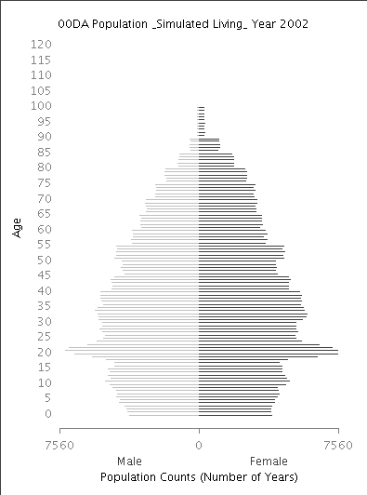
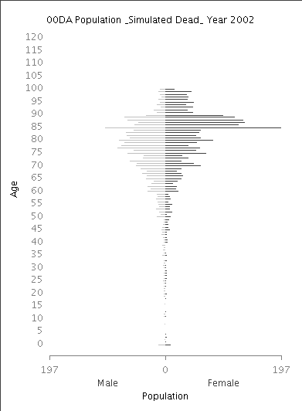
Notes:
Results only for illustrative purposes

Slide 16
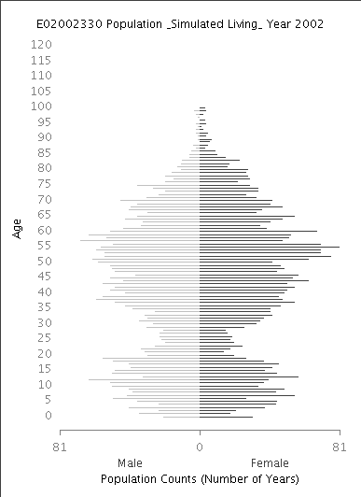
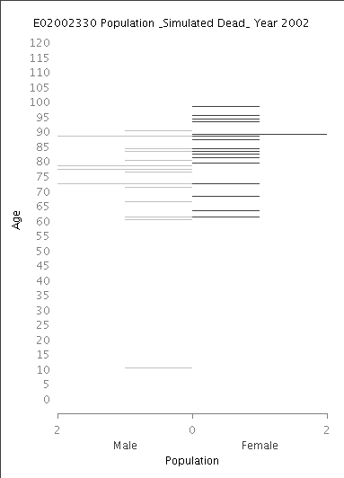
Notes:
Results only for illustrative purposes

Slide 17
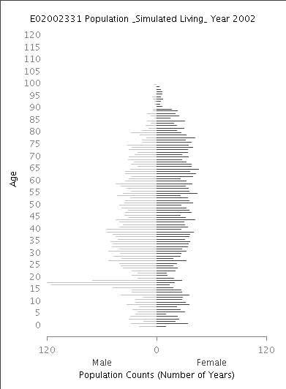
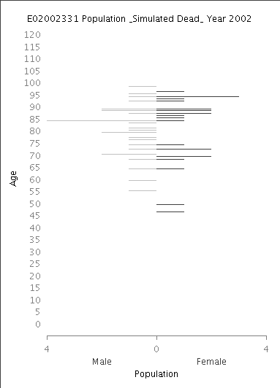

Slide 18
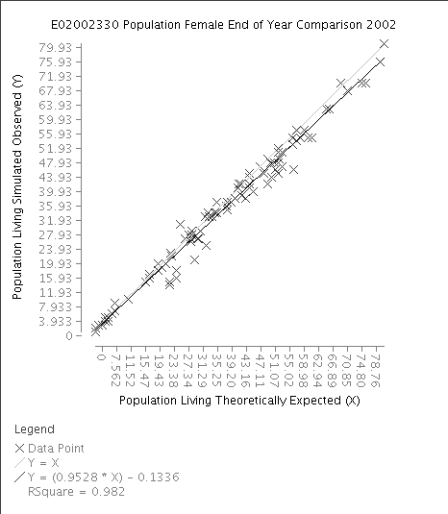
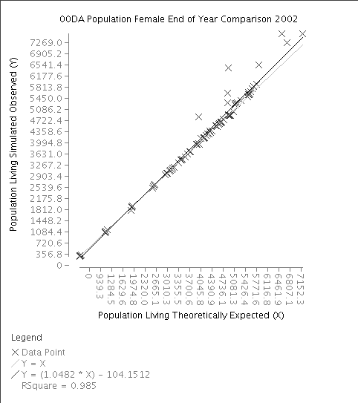
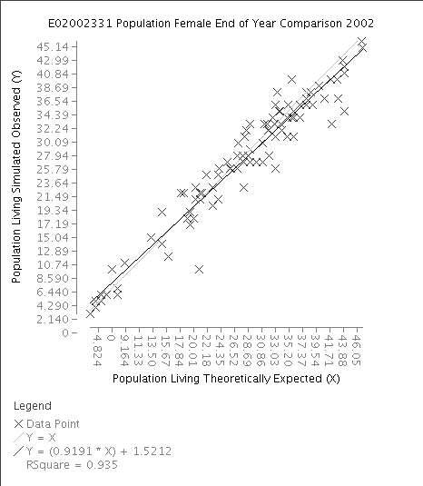
Notes:
Results only for illustrative purposes

Slide 19
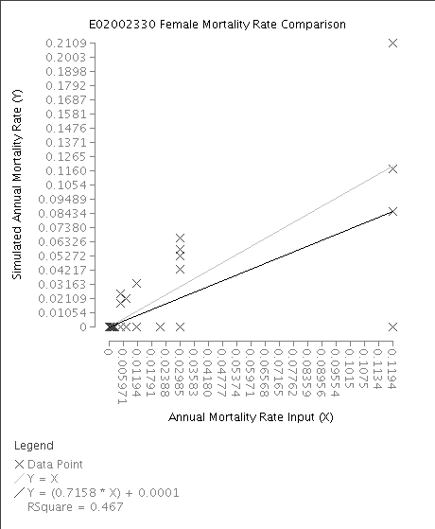
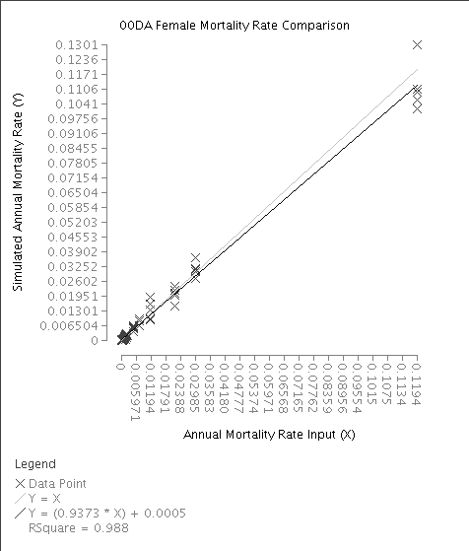
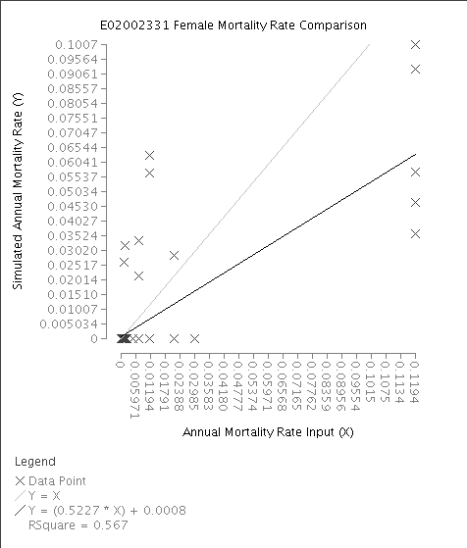
Notes:
Results only for illustrative purposes

Slide 20
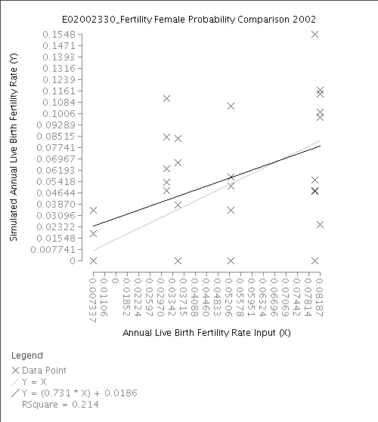
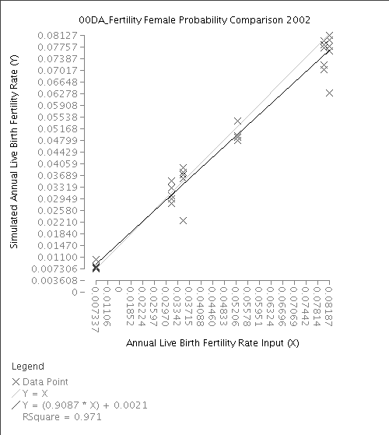
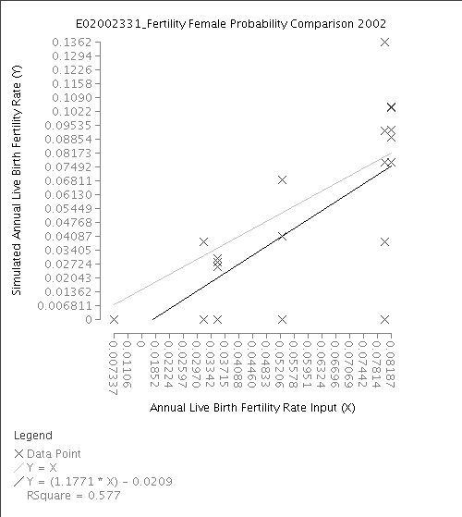

Slide 21
Initialisation
For each region
  Daily survival probabilities are calculated for each age and gender
    Death rate assumed to be even throughout the year
  Daily pregnancy probabilities are calculated for each age of potential mother
    Annual Live Birth Fertility Rates are factored for multiple births, miscarriage and death of mother
    Pregnancy rate and miscarriage rate assumed to be even throughout the year

Slide 22
  Daily migration
    Assumes migration evenly distributed throughout the year
    General migration probability calculated
    Internal migration rates are calculated for migration within the region
    In migration rates are calculated for people moving from all regions not in the study region
  Cumulative sums of migration are calculated to help determine
    The region destination for each out migration
    The subregion destination for each in migration

Slide 23
Each person is initialised
  Assigned a date of birth
  Assigned to a subregion as usually resident
  Females are assigned pregnancies and due dates

Slide 24
Daily Simulation
For each person
  Do they die?
  Is it their birthday?
    If so update population statistics
  Do they migrate?
    If yes, find out where they move to
For each female
  If pregnant do they have a miscarriage
  If due give birth
  If not pregnant, determine if they become pregnant

Slide 25
Having gone through the population for all regions in the study region
  Migrate those migrating out of the study region
  Migrate those migrating within the study region
  For migration into the study region from outside of the study region
    Create individuals
      Assigning date of birth
      Record migration origin location
      Assign subregion usual resident location

Slide 26
How?
Designed for (scalability) simulating large populations with large numbers of regions and subregions
  Individual level data stored in collections which are swapped to and from slower access storage as required
  Numerical indexes are stored in mapped collections
Computational demands are considerable
  Consider simulating a single region, population ~1 million, with ~10 thousand subregions
    Can all the data be stored in the available fast access memory?
Notes:
Giga Byte (GB)
Central Processing Unit (CPU)

Slide 27
  For a simple model, a 10 year simulation might take many days with only one CPU
    Each individual in the population is updated ~3650 times
  The amount of persistent data produced and that we want to store is in the order of tens of GigaBytes
  For a UK Simulation there are in the order of 60 million individuals and 200 thousand subregions
Grid enabled
Parallelisation
Numerical precision
  Java BigDecimal

Slide 28
Results
Results for simulations without migration
  Provide confidence in daily probability calculations for natural processes
    The expected amounts of deaths, pregnancies, miscarriages and births result at a regional level
  Variation
    At sub-regional level can be large
    At regional level are generally small
    At aggregated sub-regional level are intermediate
    For less frequently occurring events is greater

Slide 29
Variation in results
10 runs
  Everything the same except the pseudo-random seed start point

Slide 30
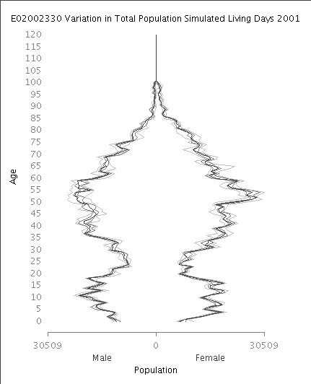
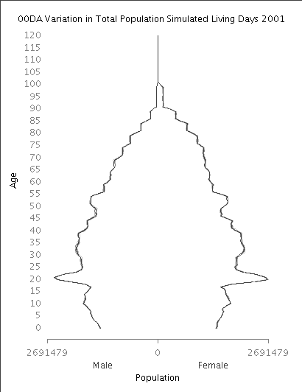
Notes:
Results only for illustrative purposes

Slide 31
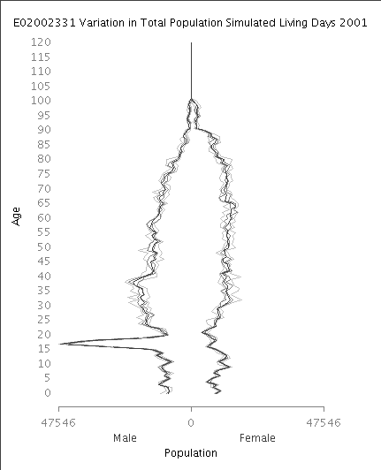

Slide 32
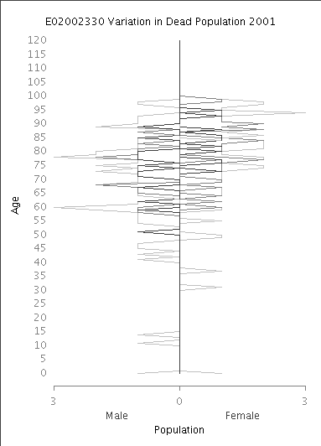
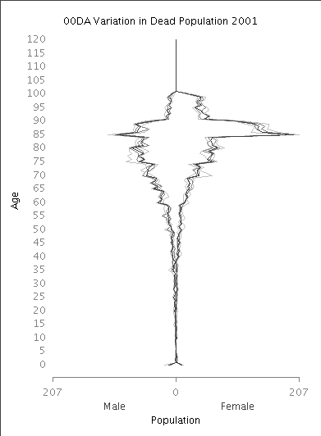
Notes:
Results only for illustrative purposes

Slide 33
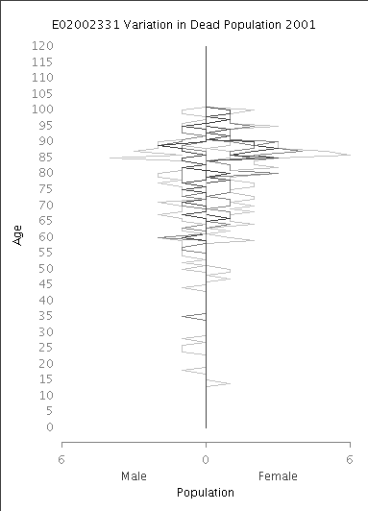

Slide 34
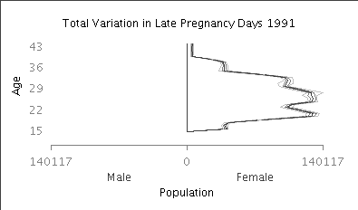
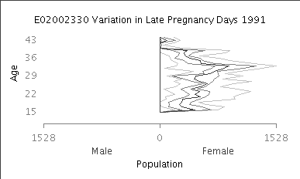
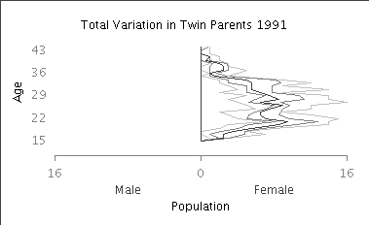
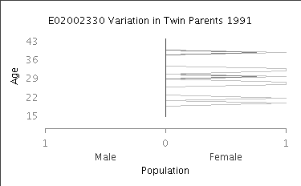
Notes:
Results only for illustrative purposes

Slide 35
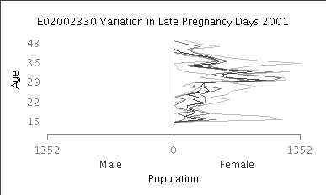
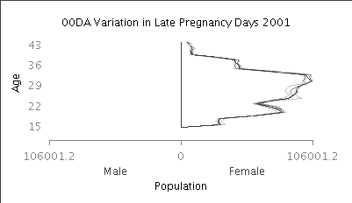
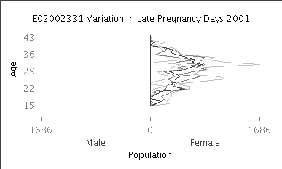

Slide 36
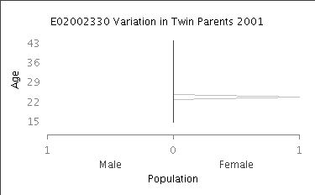
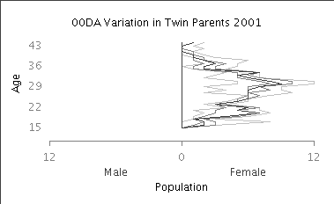
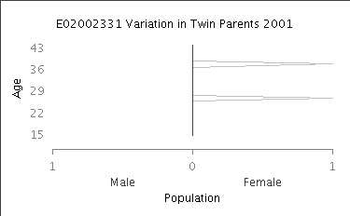

Slide 37
Migration
Types of migration modelled
  Immigration
  In migration to Study Region
  Out migration from Study Region
  Internal migration within Study Region
Input data
  2001 UK Population Special Migration Statistics
    LAD to LAD flows by age and gender
    OA to OA flows by age and gender
Region (LAD to LAD) flows are primarily used

Slide 38
Subregion (OA to OA) flows are used to assign individuals to subregions with each region
A migration factor and a minimum flow

Slide 39
Plans and Next Steps
Add emigration to the model
Detailed results statistics for migration
Simulate population change in West Yorkshire from 2001 to 2011
  Vary migration factor and minimum flow
  Present results at an appropriate event
  Publish a paper on the demographic simulation model and the results for West Yorkshire
Simulate population change for all of England from 2001 to 2011
  Compare results with 2011 census data
  More publication

Slide 40
Further modelling
  Use Nik Lomax's estimated migration flows for 2001 to 2011
  Constrain migration using subregion area classifications
  Allow for variations in mortality, pregnancy, miscarriage and migration rates over the year
    Student migration
  Migrating groups (families/households)
  Fathers

Slide 41
Seek data for more detailed simulations
  Annual and regional miscarriage data
Seek collaboration with statistical offices
Seek further funding
  Secondment to UK ONS funded by ESRC?

Slide 42
Feedback
Much can be done to improve this work
What has emerged is something like the simplest demographic model
  There is much detail to add...
Anyone interested in writing this up or collaborating in anyway?
Any questions?

Slide 43
Thank You
http://bit.ly/TStpJP

